Slide 1

Cable Driven Parallel Robots with Unknown Anchor Points

Slide 2
Overview
Introduction
Methodology
Demonstrations

Slide 3
Introduction

Slide 4
Overview
CDPR : Parallel Manipulators
Degrees Of Freedom
Under constrained
Constrained
Over constrained
Notes:
CDPRs with n DOFs driven by m cables can be classified into three types according to the mobility and statics: under- constrained CDPRs when n+1 >m, fully constrained CDPRs when n+1=m, and redundantly constrained CDPRs when n + 1 < m, respectively

Slide 5
Methodology
Assembly Design
Kinematics
Static Analysis
Control Theory
Dynamics
Software

Slide 6
Assembly Design

Slide 7
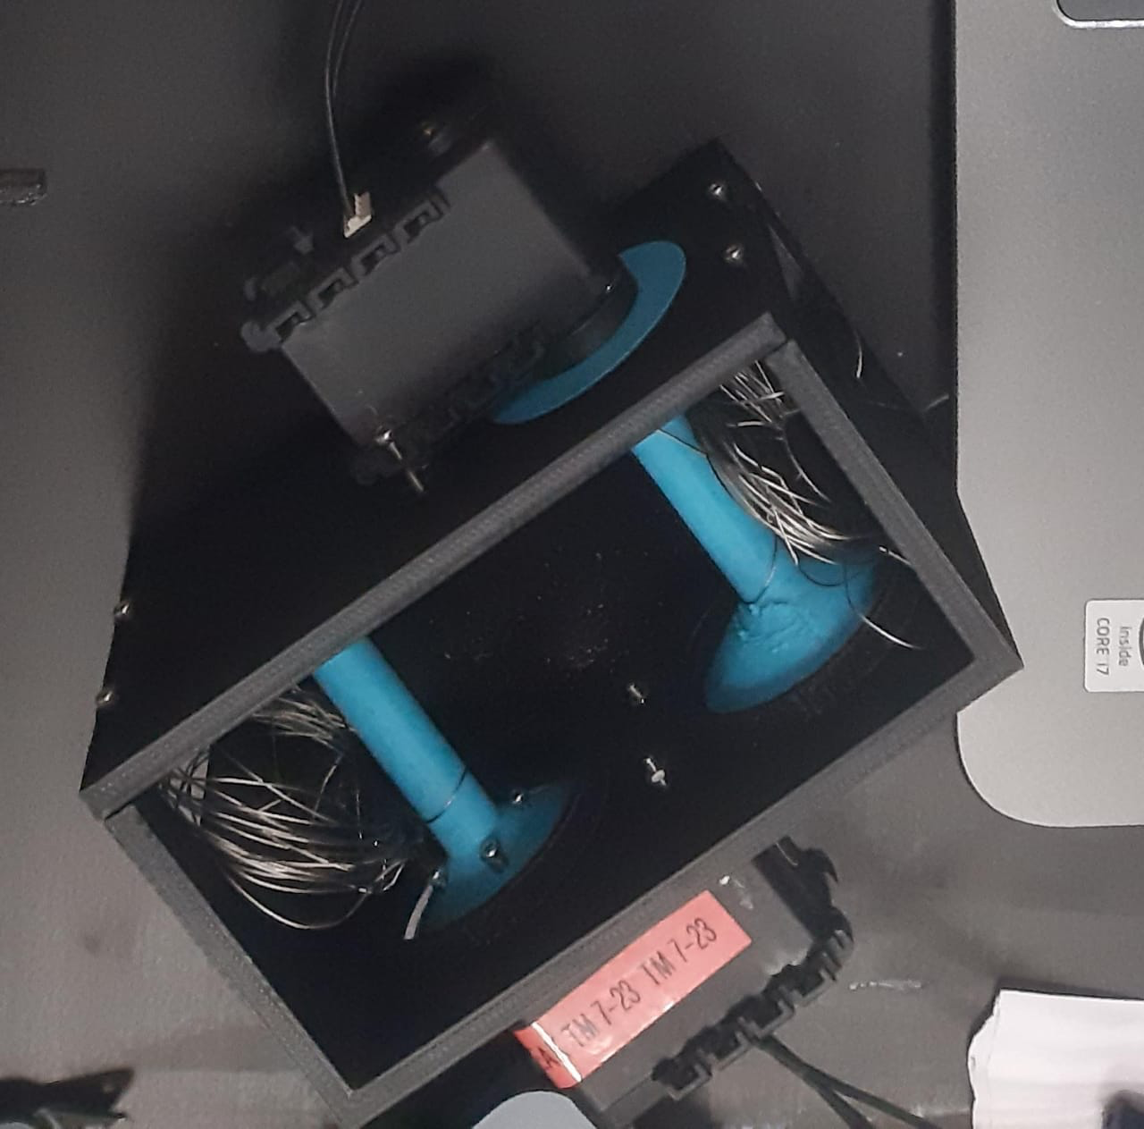
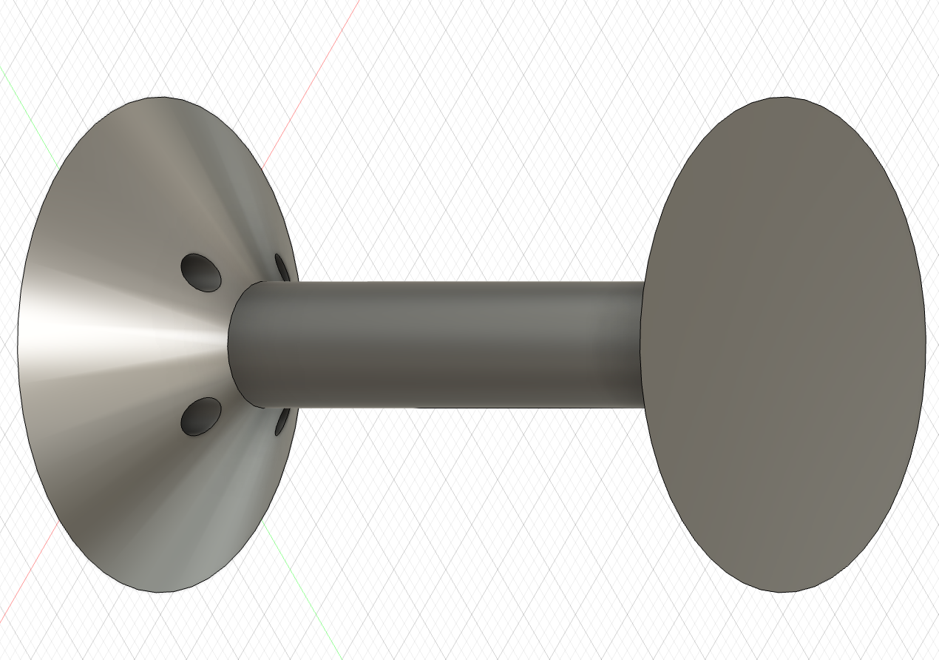
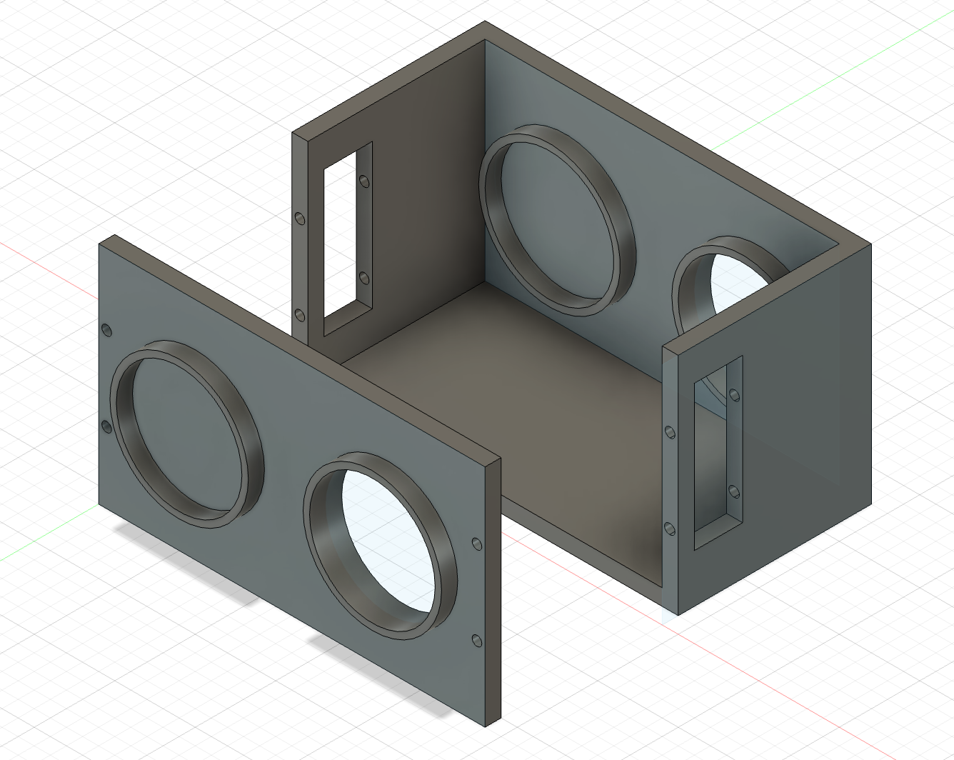
Assembly Design : End Effector
Strings
Shafts
Box

Slide 8
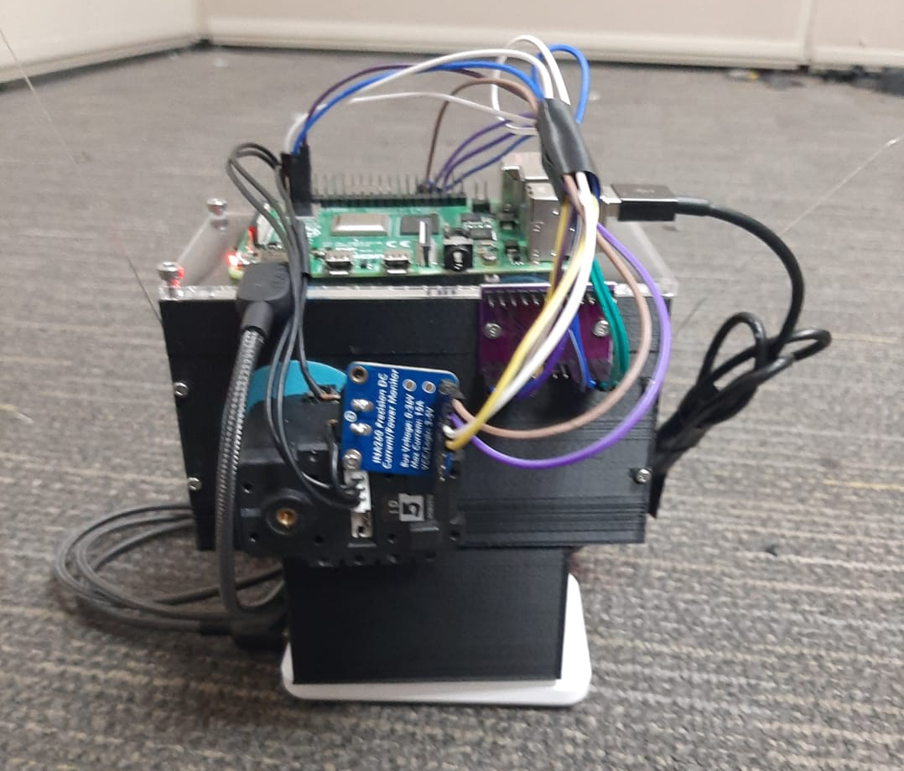
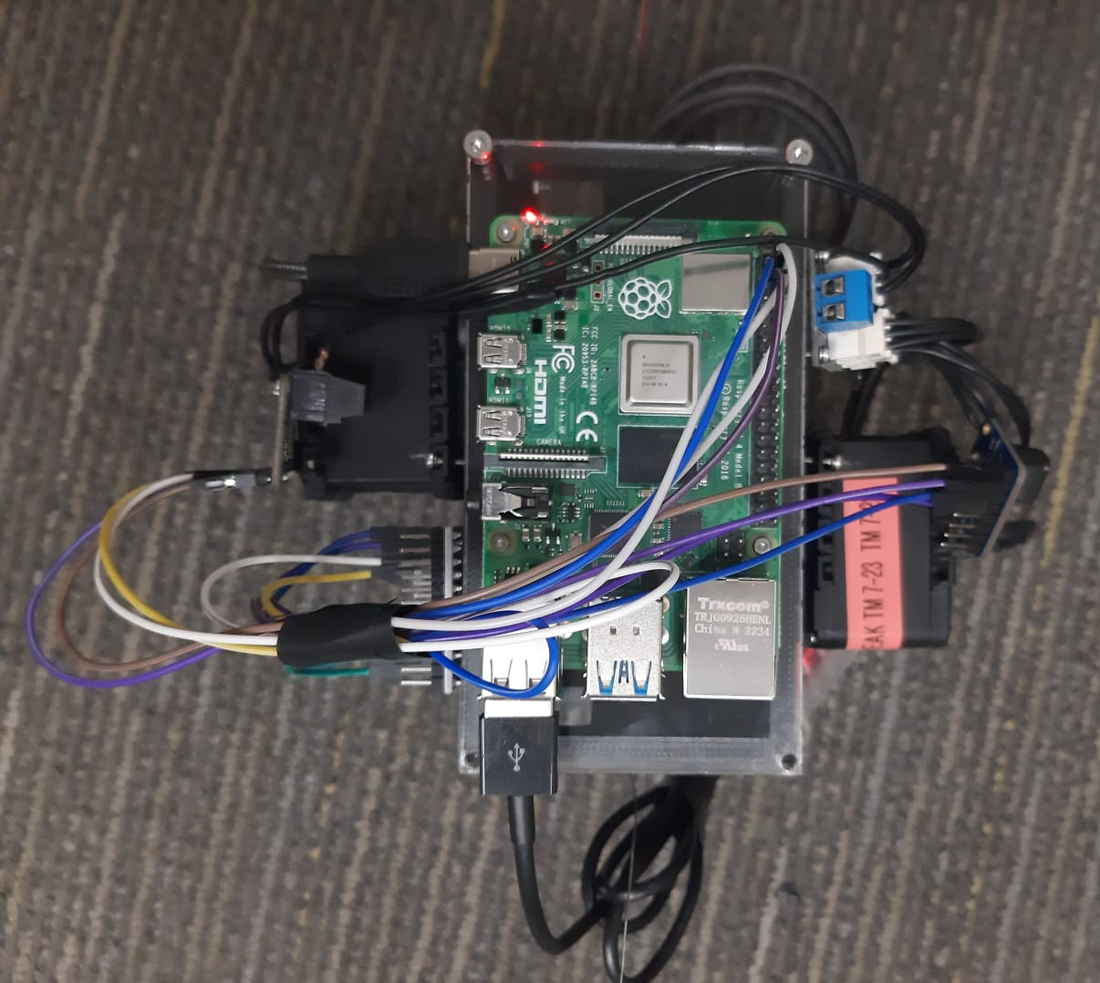
Hardware
Raspberry pi 4b
End effector : Side View
End effector : Top View
Dynamixel AX12 motors
INA260 power sensor
TCA9548A Multiplexer

Slide 9
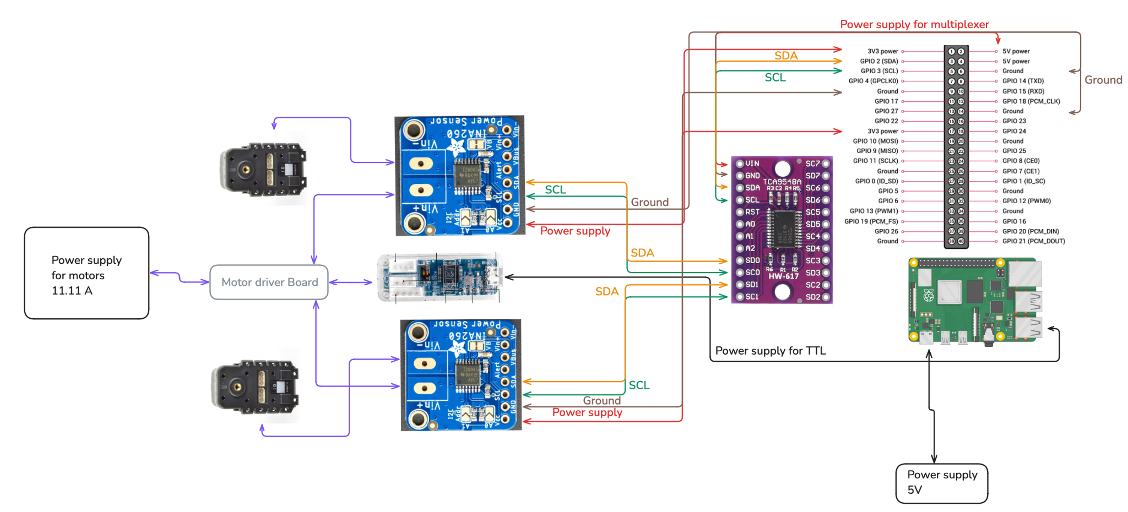
Hardware Connections : Electrical Circuit

Slide 10
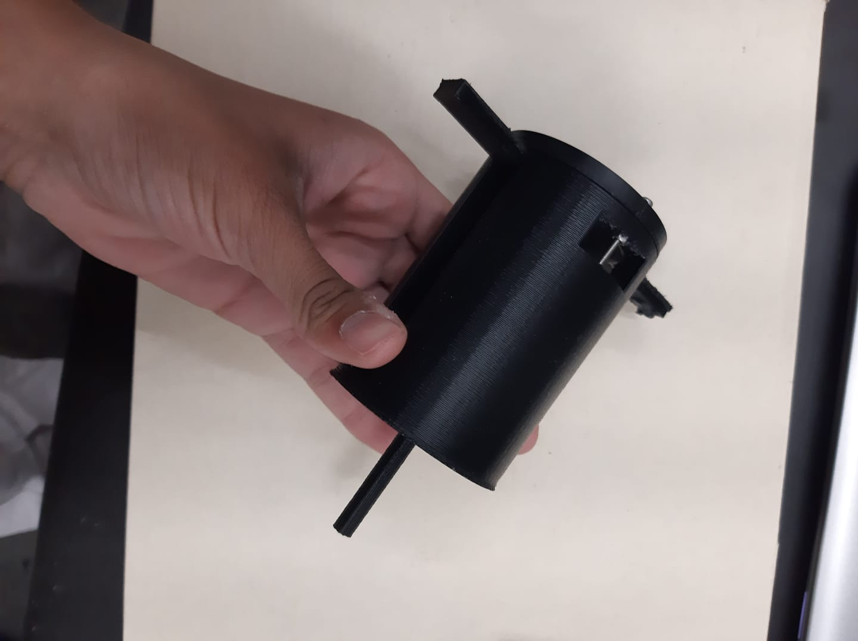
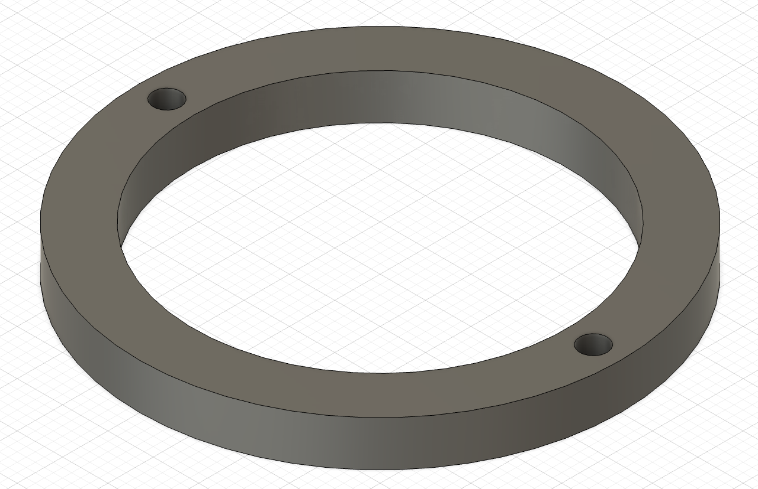
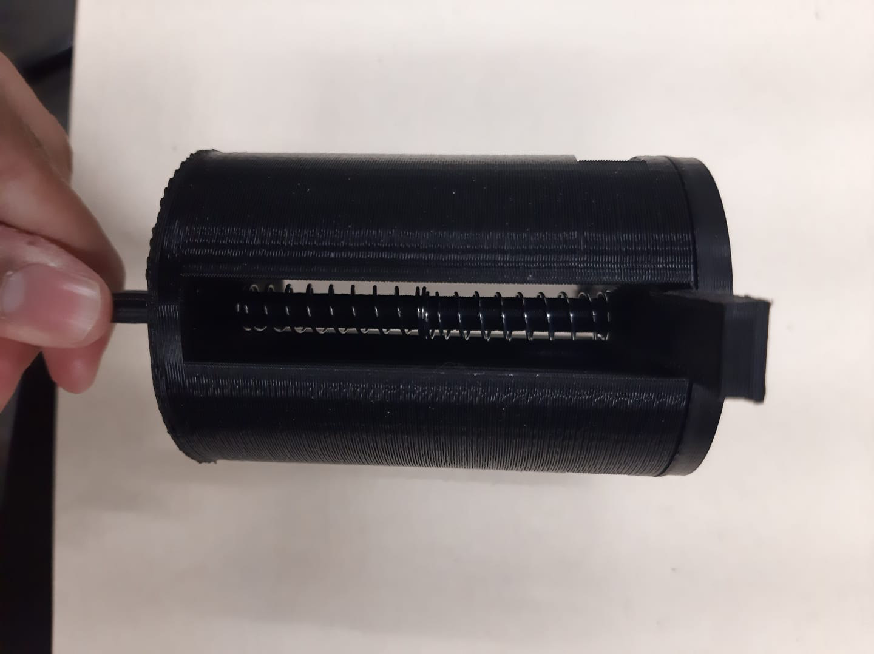
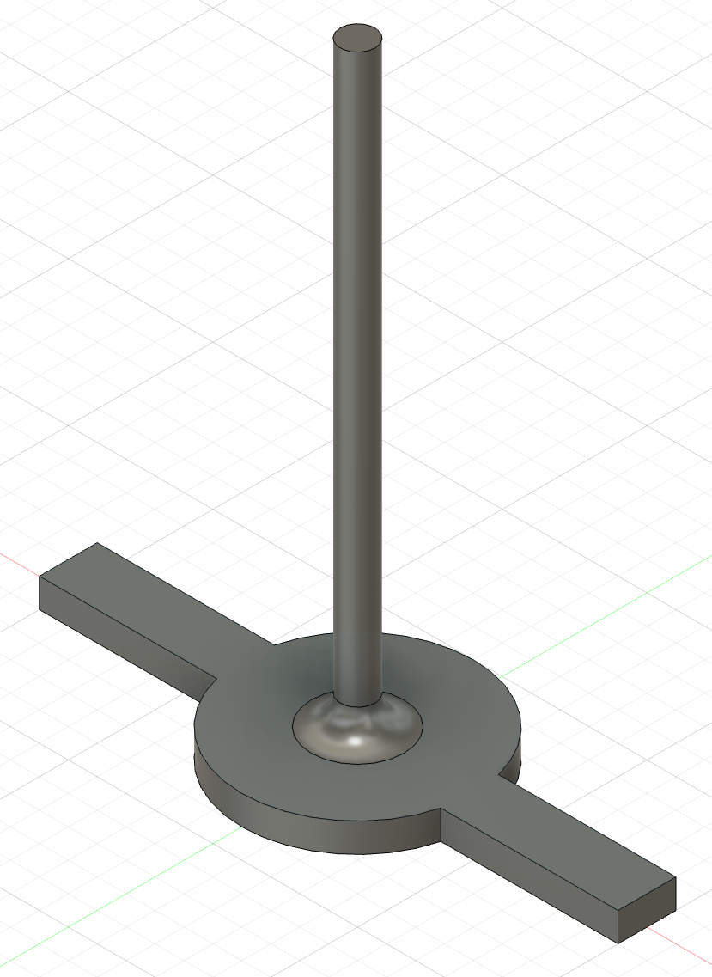
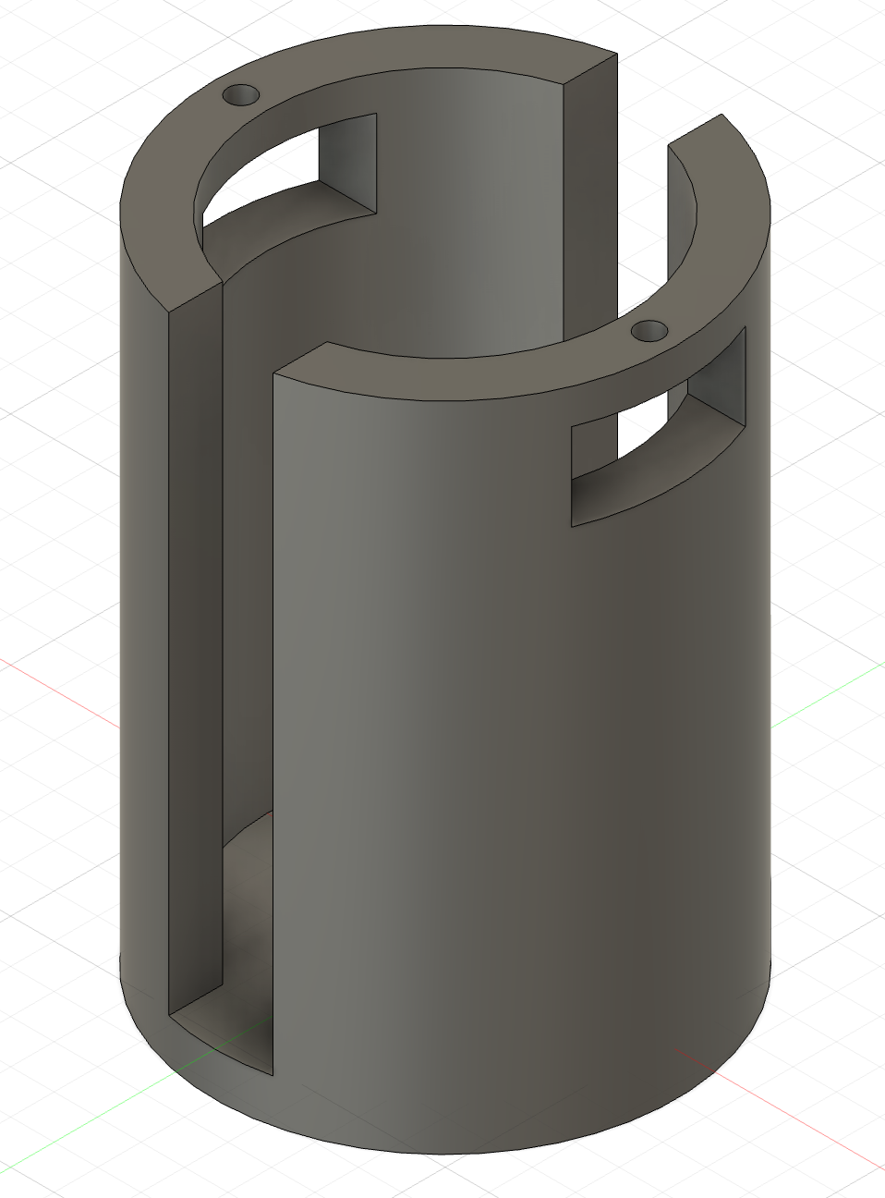
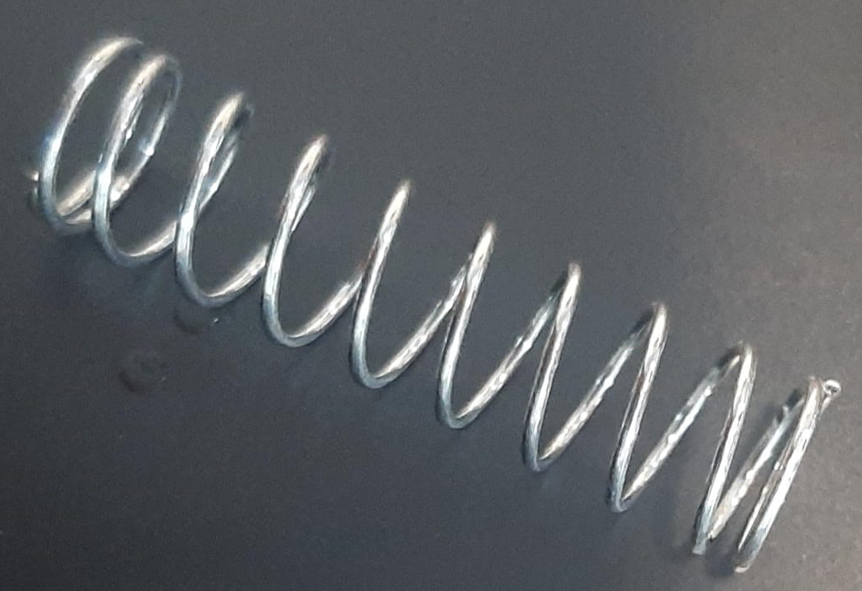
Assembly Drawing : Projectile Launcher
Lid
Pulling rod
Drum
Springs in series

Slide 11
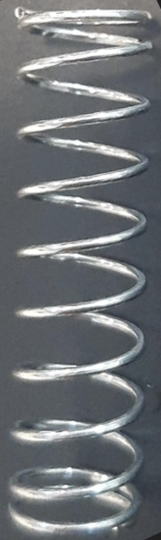
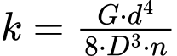
Spring Design
D
Calculations :
G = 77 x 10^9 Pa
d = 0.0016 m
D = 0.008 m
k = 11200 N/m
G = Shear modulus of material
d = wire diameter
D = Mean coil diameter
n = number of active coils
d

Slide 12
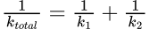
Spring Design
Calculated spring constant ( calculations are demonstrated in Dynamics section ) for 2m height and 50g mass : 1366 N/m
Calculated spring constant of the spring which I have using previous equation : 11200 N/m
Spring 1 , k_1
Spring 2 , k_2

Slide 13
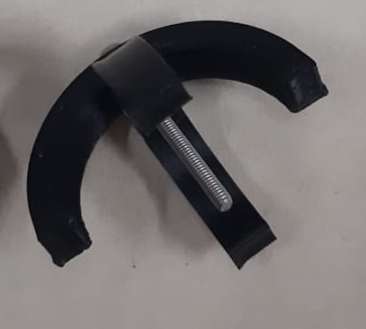
Anchors used
Fitting the cable end here which can be projected upwards

Slide 14
Kinematics

Slide 15
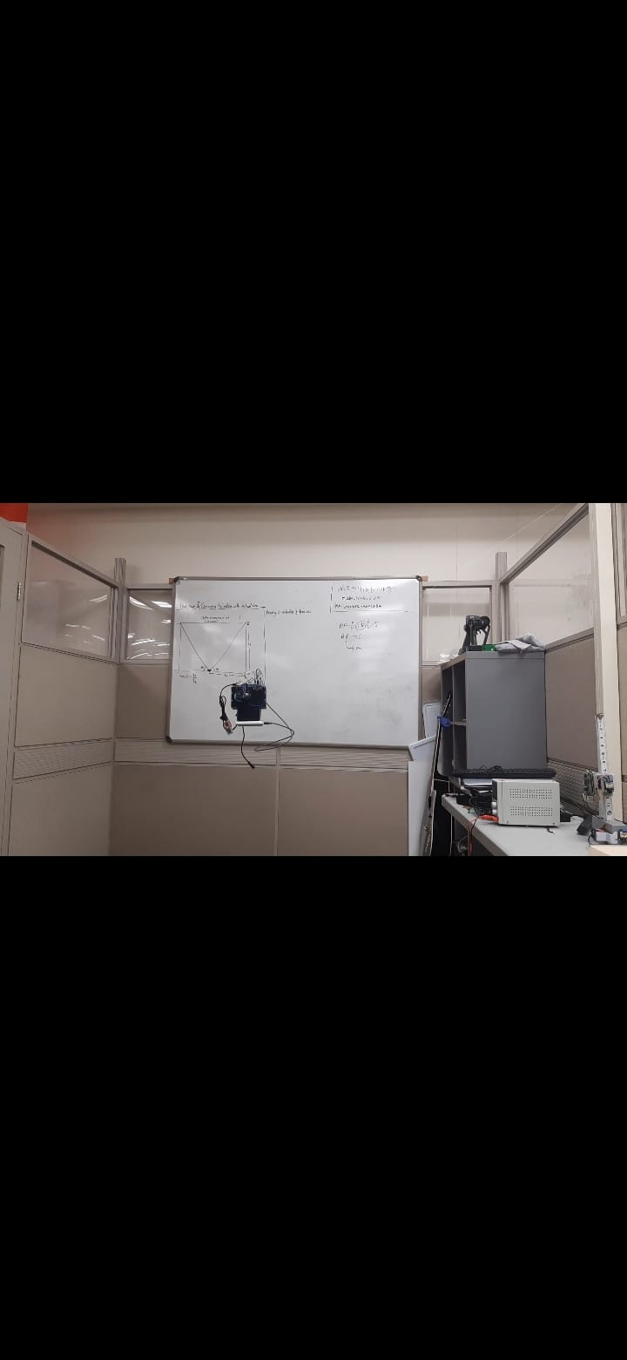
Calculating new position of end effector
Given :
L1 : initial length of the cable 1
L2 : initial length of the cable 2
A1 : Anchor point 1 ( x1,y1 )
A2 : Anchor point 2 ( x2, y2 )
Position coordinates of EE : (xi , yi )
n1 : no. of rotations for shaft 1 needed to reach final position
n2 : no. of rotations for shaft 2 needed to reach final position
r : radius of shaft on which cable is wound
Anchor point
A1 (x1,y1)
Anchor point
A2 (x2,y2)
L1
L2
Position of EE : (x,y)

Slide 16
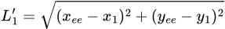
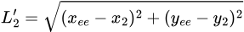
Equations providing solution :
For calculating L1’ and L2’ :
For calculating the final coordinates of ee :
To find :
L1’ : Final length of cable 1
L2’ : Final length of cable 2
Final position coordinates of EE

Slide 17
Static Analysis

Slide 18
Calculating Tensions
Anchor point
A1 (x1,y1)
L2
Anchor point
A2 (x2,y2)
L1
T2 : Tension in cable 2
T1 : Tension in cable 1
u1 : unit vector along L1
u2 : unit vector along L2
Position of EE : P : (x,y)
mg ( weight )

Slide 19
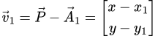
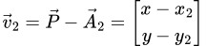
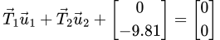
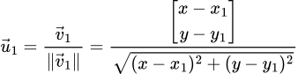
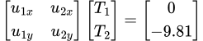
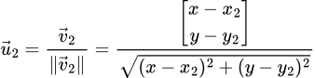
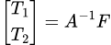
Position vectors :
Unit vectors
3. Force balance : Equilibrium equation
4. Matrix representation :
5. Solution for Tensions :

Slide 20
Control Theory

Slide 21
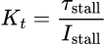
Relation between motor torque and motor current
Direct proportionality of motor torque and motor current :
where : T_s = stall torque
I_s = stall current
Dynamixel motor specifications
Stall torque = 1.5 Nm
Stall current = 1.5 A
Thus ,
Gear ratio = 254 : 1
Final equation :
T_o = torque output
I_i = Input current : Current absorbed by the motors

Slide 22
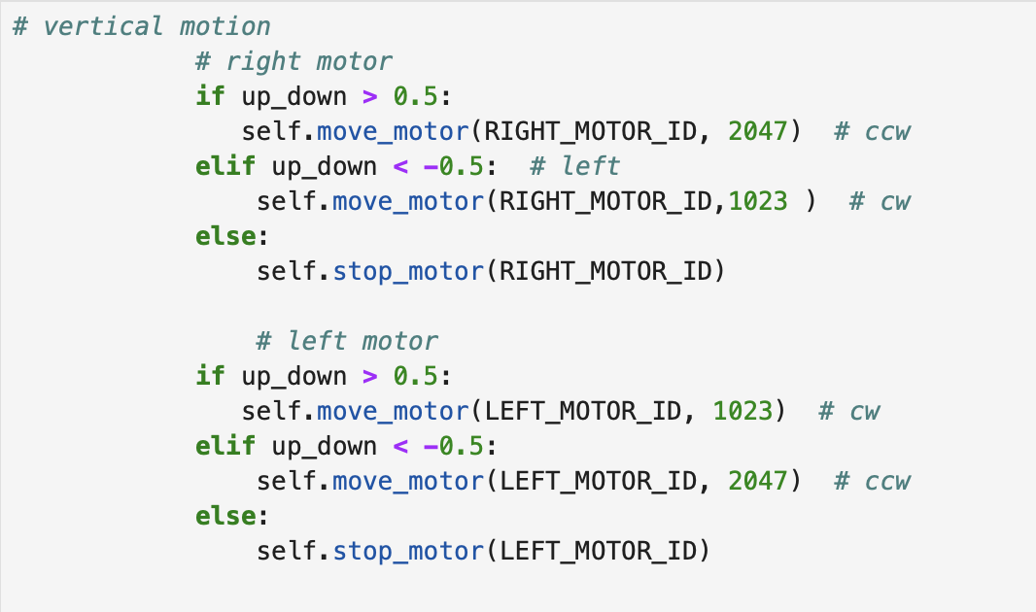
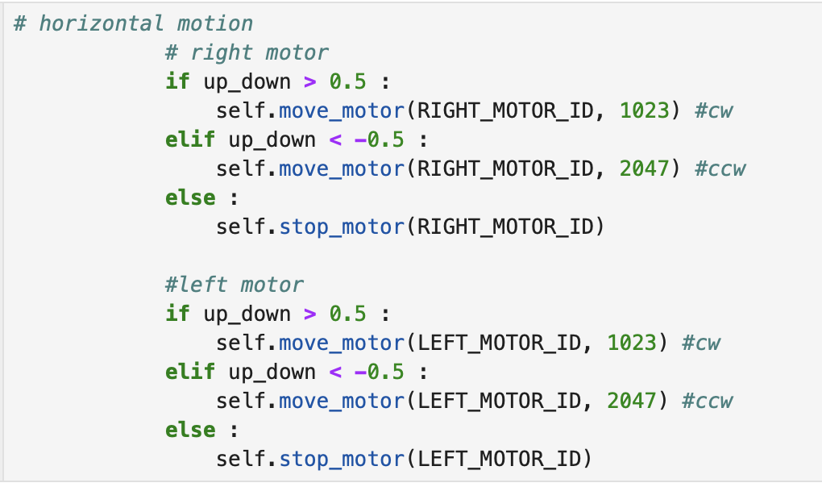
Motor Control via ROS node in Python

Slide 23
Dynamics

Slide 24
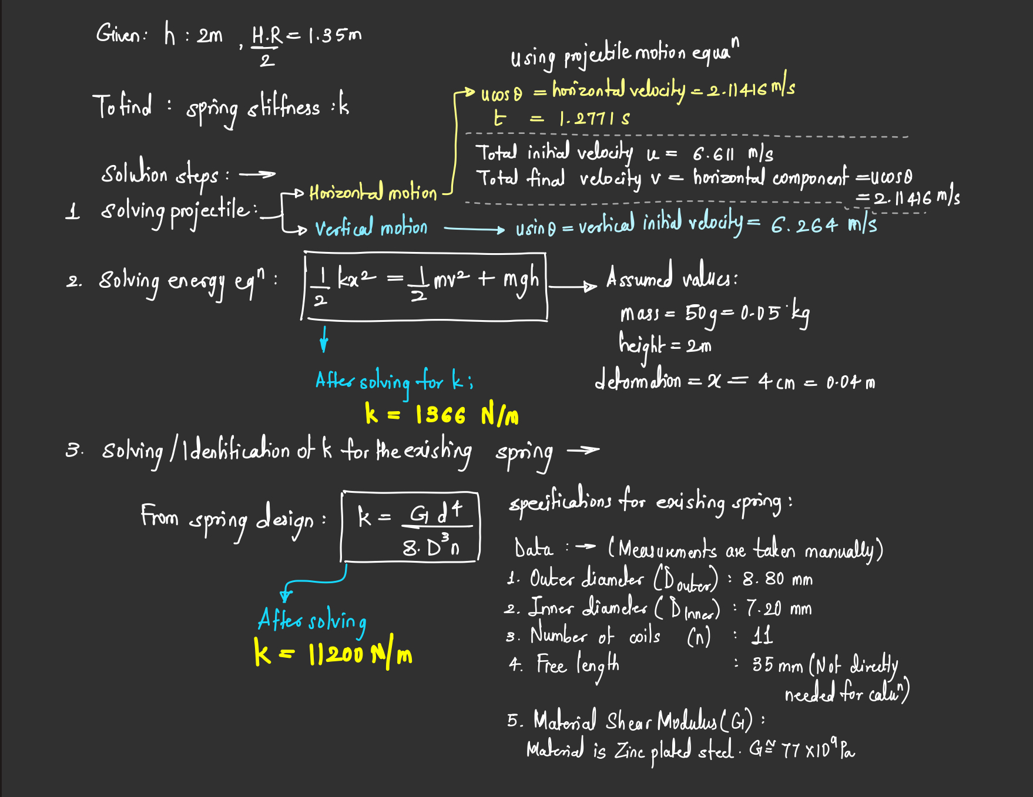
Motion analysis for projectile launcher

Slide 25
Software

Slide 26
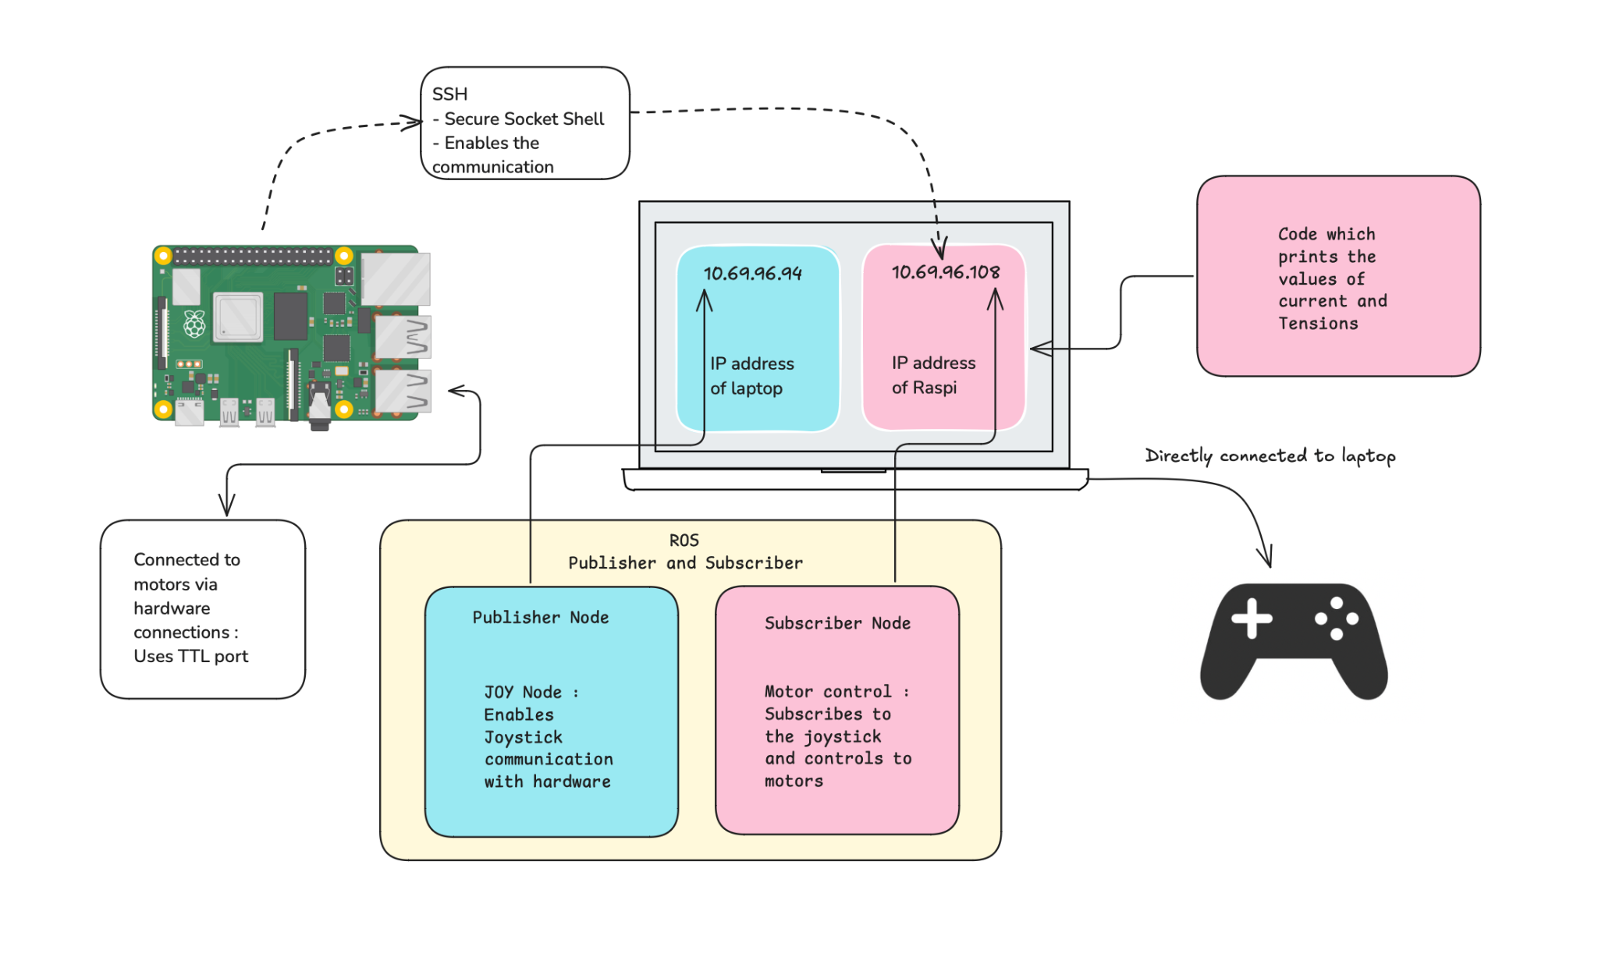

Slide 27
Demonstrations
Path of End effector
Heat Map
Motion of End effector :
Vertical motion
Horizontal motion

Slide 28
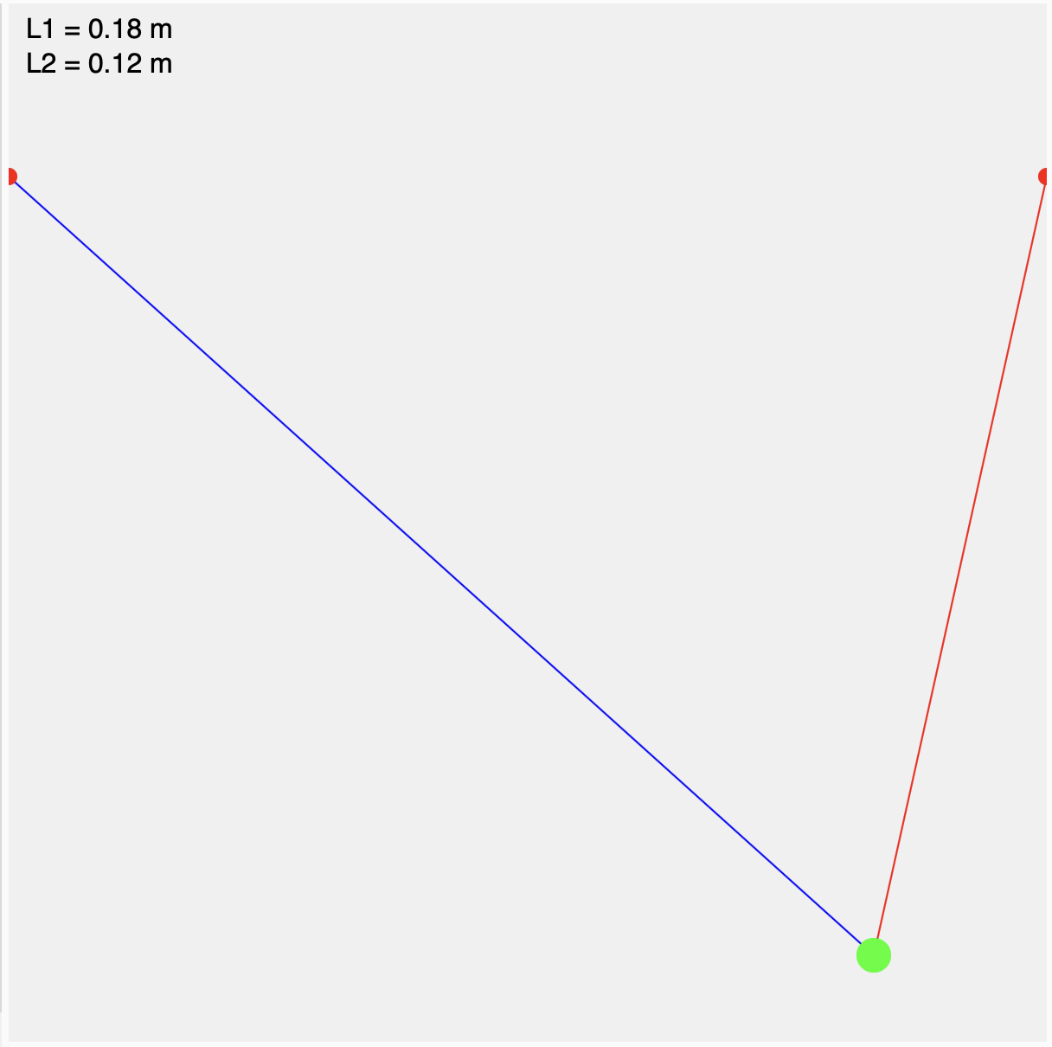
Path of End effector :

Slide 29
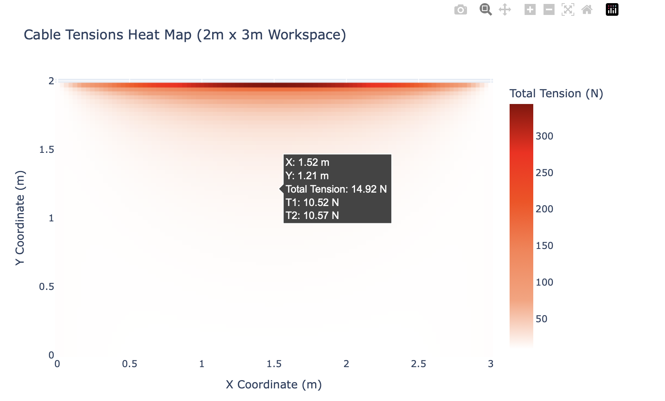
Heat map for simulation

Slide 30
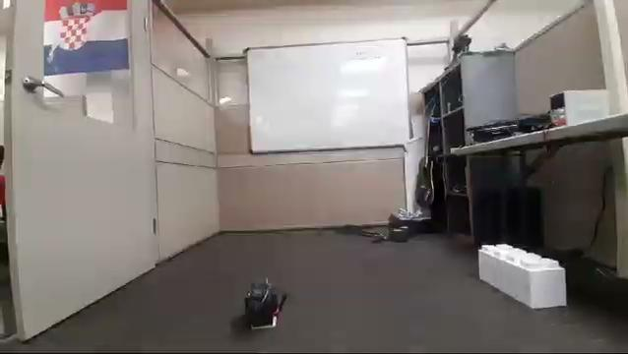
End effector : Vertical Motion

Slide 31
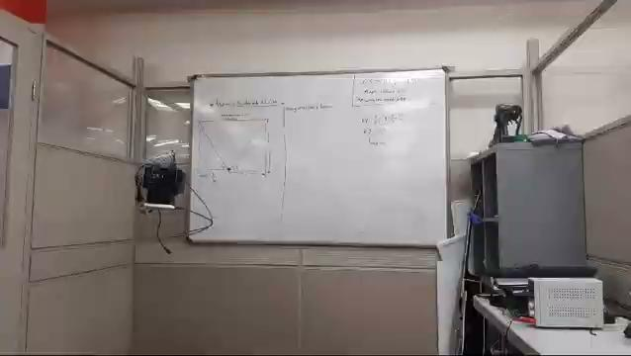
End effector : Horizontal ( zig zag ) motion

Slide 32
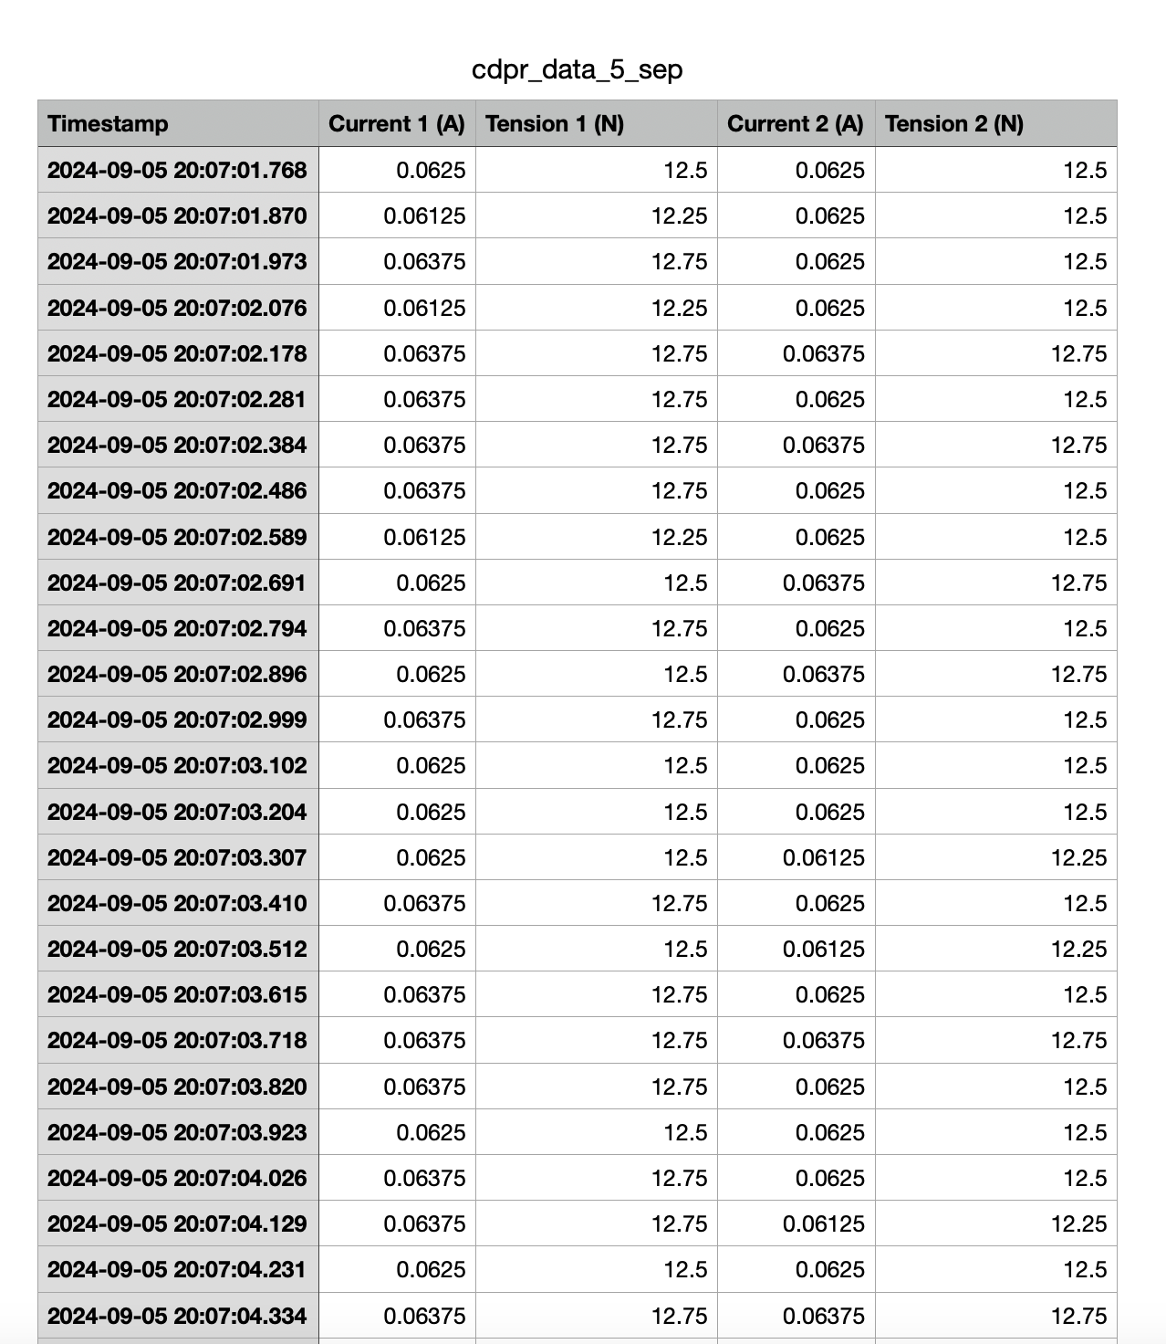
Data :
Analysing and checking the values
for sanity check

Slide 33
Thank you !

